Slide 1
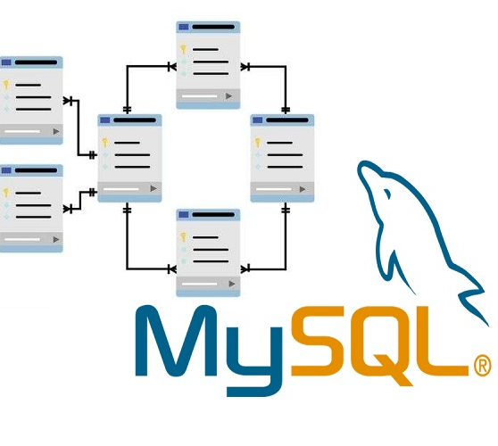

Introduction to MySQL
By – Ashutosh Dhakulkar
Group -1

Slide 2
Topics to be covered
1. Origin of MySQL & Purpose
2. What is MySQL
4. Categories of Datatypes
Thank You
3. Introduction to MySQL Datatypes

Slide 3
Origin of MySQL & Purpose
History:
Developed in the 1970s at IBM by Donald D. Chamberlin and Raymond F. Boyce.
ANSI ((American National Standards Institute) and ISO (International Organization for Standardization) standardize SQL to ensure compatibility and widespread use.
Purpose:
Querying data: Retrieve specific data from databases.
Updating data: Insert, update, and delete records.
Database management: Create and modify database structures (tables, indexes, views)
.
1
2
3
4

Slide 4
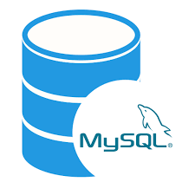
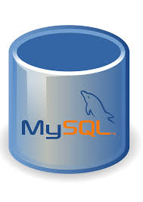
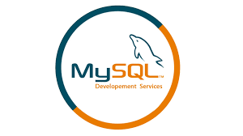
What is MySQL
General Overview:
MySQL: MySQL is an open-source relational database management system (RDBMS) widely used for managing and organizing data by Oracle Corporation.
Business Context:
MySQL: MySQL is a powerful and cost-effective database management system used by businesses of all sizes to manage their data efficiently. As an open-source platform, it provides a robust and scalable solution for storing and retrieving data.
Technical Definition:
MySQL: MySQL is an open-source RDBMS that utilizes Structured Query Language (SQL) to interact with and manage data stored in relational tables. It supports multi-user access to multiple databases, allowing complex querying and transaction processing.
2
1
3
4

Slide 5
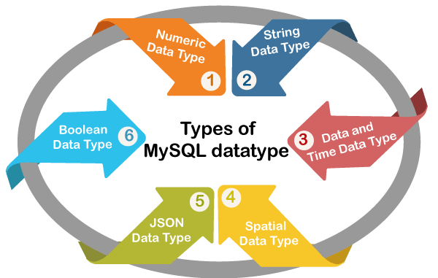
Introduction to MySQL Data Types
Purpose of Data Types:
Define the nature of data that can be stored in a table.
Ensure data integrity and optimize storage.
Enable the SQL engine to understand how to handle data.
3
1
2
4

Slide 6
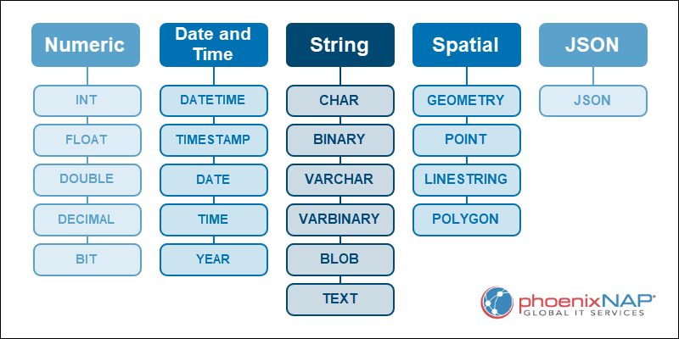
Why Data Types Matter ?
Affect performance and storage.
Influence data validation and manipulation.
Facilitate accurate querying and reporting.
Categories of Data Types:
Numeric
Character/String
Date/Time
Binary
Other (Spatial, JSON, etc.)
4
1
2
3

Slide 7
Thank You

